Slide 2
Delphix User Experience
Bobby Durrett, Technical Architect

Slide 3




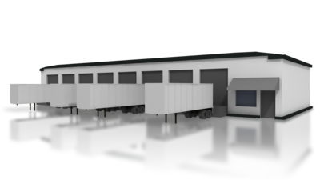




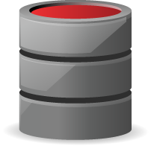
Introduction – US Foods
Bobby Durrett– Oracle DBA, performance tuning specialist
US Foods – 2nd largest food distributor in USA
Two key applications share production database
FOOD SUPPLIERS
CUSTOMERS
Heavy batch loads
Supplier App
Customer App
Notes:
4 ANIMATION STEPS
I appreciate the chance to talk with you about my experience with Delphix. Let me introduce my company and myself first. I work for US Foods which is the second largest food distributor in the United States. We have about $20 billion in revenue each year and about 25,000 employees. My name is Bobby Durrett and my title is Technical Architect. I work in our Oracle database group and I am the technical lead for our Delphix project. In my work with Oracle I am most interested in performance tuning.
To understand our Delphix project you need to know a little bit about food distribution. We have suppliers and customers. Suppliers provide us with products that restaurants need and customers, usually restaurants, buy them from us. Our Delphix system supported a project that moved an application related to suppliers off of our mainframe and on to a Unix and Oracle system. We chose to put the suppliers data on an existing production database that already had a large customer application.
The new application and the old one are both heavy batch processing systems. On the weekend the previous week’s data is processed and our database system is heavily taxed. Our existing customer batch jobs struggle to return results in time for our Monday morning deadlines. It was important for the project to test that the new suppliers batch processing would complete over the weekend. It was also key that the added load from the new supplier batch jobs would not slow down the existing customer batch jobs and cause them to miss their deadline.
This talk contains a series of lessons we learned during our work with Delphix. Each slide describes one important concept. Related slides are grouped together. I picked key things we learned along the way hoping that these would be helpful to you.
I plan to talk for about 30 minutes and then take time for questions. Feel free to interrupt me in the middle if you want to ask a question before the end. My goal is to make this useful to you so I want to answer your questions.
First I’m going to talk about the architecture both before and after we started using Delphix.

Slide 4



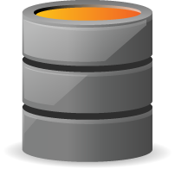
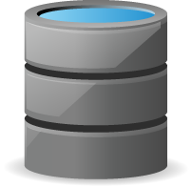
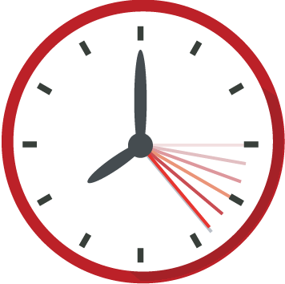
Architecture of Original Customer Application
Used Oracle import and export utilities for refresh
Refresh took several days
Usually only performed partial refresh
DEV and QAT used expensive SAN, had less memory
Unix Physical Host
Unix Physical Host
DEV
QAT
PROD
► ►
► ►
► ► ►
► ► ► ► ► ► ►
SAN
SAN
SAN
1 TB
Slow Refresh
5 TB
6 TB
Subset of production data
Notes:
3 ANIMATION STEPS
Before we heard about Delphix we planned to support this new suppliers project using the same approach that we normally use. For example, in our existing customer application we had three databases - DEV, QAT, and PROD. New packages and tables were developed in DEV. These were migrated to QAT and tested there. The final migration to production was from QAT to PROD. When testing required up-to-date production data we used Oracle’s export and import utilities to refresh tables on QAT or DEV from PROD. Usually we did not refresh all of the tables because this would take several days. As a result our DEV and QAT databases never had completely up-to-date data. The DEV and QAT database files were stored on the same type of expensive SAN storage that we used for PROD. To save money on disk space DEV and QAT had less data than PROD.

Slide 5

Architecture for Suppliers Project w/o Delphix
CUSTOMERS APP
Added storage expense
DEV
SIT
Continued difficulty performing refresh
► ► ►
Storage $$$
QAT
PROD
SAN
SAN
1 TB
1-6 TB
► ► ►
SUPPLIERS APP
SAN
SAN
DEV
SIT
6 TB
6 TB
► ► ►
Storage $$$
Storage $$$
SAN
SAN
1 TB
1-6 TB
Slow Refresh
Notes:
2 ANIMATION STEPS
The suppliers project requested several new databases each requiring a large amount of disk space. At that time we started using SIT or system integration test databases. Now the database changes would be migrated from DEV to SIT and from SIT to QAT and then to PROD. The idea was to continue to use our existing QAT database and PROD database for both customers and suppliers. But the customers app would have its own DEV and SIT databases and the suppliers app would have its own DEV and SIT. So, the project required us to add three new databases which required several terabytes of storage. Also, the plan was to continue to use export and import for refreshes as we had on earlier systems.

Slide 6
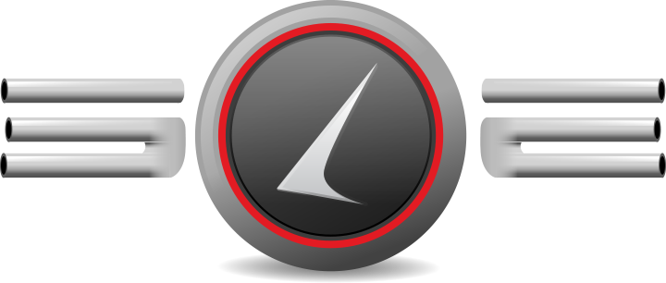
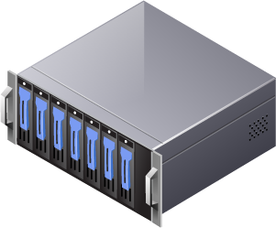
Architecture with Delphix
Sync with production
CUSTOMERS APP
DEV2
SIT
20TB virtual 8TB real
► ► ►
QAT2
PROD
VDB
VDB
1 TB
1-6 TB
SUPPLIERS APP
VDB
SAN
DEV
SIT
6 TB
6 TB
► ► ►
VDB
VDB
1 TB
1-6 TB
Notes:
2 ANIMATION STEPS
Around the time that the project was getting kicked off we came up with the idea of using Delphix as a better way to support our development and test databases.
I was in a technical architect mentoring program and one assignment in that program was to research and present a new technology. I brought up the idea of using physical clones of production databases for testing. I had in mind using features in our storage systems or using RMAN and had not heard about Delphix.
My thought was that our export/import refresh methods would get the data that we need for testing but it would be stored differently than in production. So, the results of our testing would be accurate because the data values were the same as production. However, the performance in our test environment could be very different from that in production. The data could be stored in a very different pattern on our test databases than on our production databases. I also had the idea that a physical copy of a production database could be done more quickly than a full export/import of the database. So, we could do full refreshes more frequently and keep the test data more up to date.
My mentor liked the idea of looking at physical copies of production databases for testing and he recommended that I look at Delphix as an option.
The rest of this talk describes our experience with Delphix including the challenges we faced and the successes we enjoyed.
First let’s look at how we initially used Delphix to support the suppliers project.
We created new versions of our previous DEV and QAT customer databases and called these DEV2 and QAT2. The remaining three databases were the same new DEV and two new SIT databases that had already been requested.
Our initial plan for Delphix was to keep our databases the same as they were planned to be before we had Delphix, but to use Delphix as the storage. We had not figured out how to take full advantage of Delphix’s fast cloning. We thought of Delphix more as a replacement for our SAN storage, but keeping everything else the same.
We were able to take advantage of Delphix’s efficient use of disk storage. We were able to support these 20 terabytes of virtual databases with 8 terabytes of real storage connected to our Delphix machine. So, at first we saw Delphix as a SAN replacement that used less disk space.

Slide 7
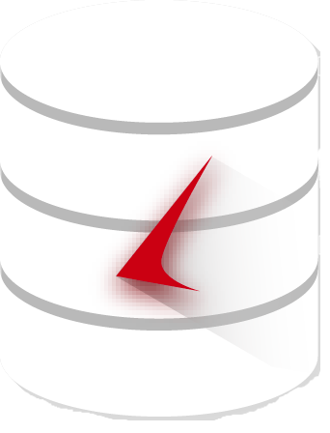
Architecture: 1:1 Correspondence of VDBs to Virtual Machines
Virtual Machine
Virtual Machine
Virtual Machine
Virtual Machine
Virtual Machine
PHYSICAL HOST (HP-UX ITANIUM BLADE)
Notes:
2 ANIMATION STEPS
Our original design using Delphix had each of the five virtual databases in its own virtual machine. A single physical machine hosted all five HP Unix VMs. This physical machine had a fast network connection back to the Delphix machine.

Slide 8
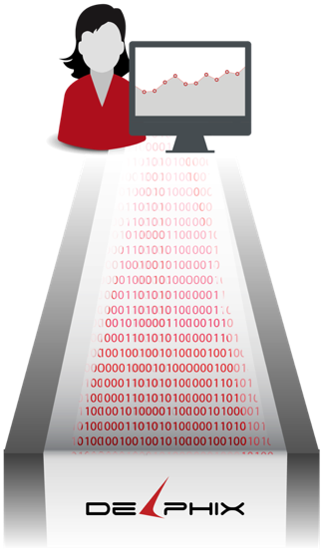

Benefits: Usability and Speed – Fast Clones
Time for full refresh from production:
Days for export/import
Hours for RMAN
Minutes for Delphix
Ease of Use
Point and click with Delphix
Manual effort for RMAN and export/import
Notes:
Now that I’ve described our initial architecture with Delphix I want to move on to the benefits we have experienced.
Throughout my time using Delphix it has been great at quickly and easily creating clones of a large production database. I think of Delphix as having “fast clones”. I use a graphical web based interface to create a new copy of a 6 terabyte production database in 15 minutes. Full export/imports of a database this large take us days, and RMAN clones take hours, and both require manual effort. But Delphix is fast and easy to use - fast clones.

Slide 9


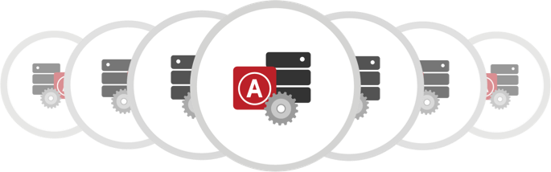
Benefits: Production Recovery with Delphix
Production data table accidentally emptied/dropped
Even with Oracle bug slowing recovery process, missing table restored in 3 hours vs. overnight with RMAN
Data recovery capability was unexpected benefit
TABLE DAMAGED
TABLE RESTORED
2 HOURS
X
Continuous Data
Protection
Restore from point in time just prior to drop
Notes:
Our upper management was very happy with a production recovery that we did using Delphix. This was an unplanned benefit of our Delphix project.
The production database that we have connected to Delphix needed a table to be recovered. Either a job ran at the wrong time or the table was emptied by mistake.
Without Delphix we would have used RMAN to do an incomplete recovery to the time just before the table was damaged. To use RMAN we would have to find a host with enough free memory and disk space. The restore and recovery of a 6 terabyte database would take a number of hours. The equivalent in Delphix took several minutes.
An Oracle bug that we hit during our recovery multiplied the value of Delphix’s fast cloning. Because of the bug our first recovery failed and we had to start over. I researched the bug and found a workaround. It took me two or three times to correctly apply the workaround so each time I had to start over. Even with three or four restores and recoveries we had the missing table back in three hours.
The same process with RMAN, three or four RMAN restores and recoveries of a 6 terabyte database, would have taken all night.
This example supports my description of Delphix as “fast clones”. It is really nice being able to pick a time in the past 7 days and create a copy of a 6 terabyte database in minutes.

Slide 10

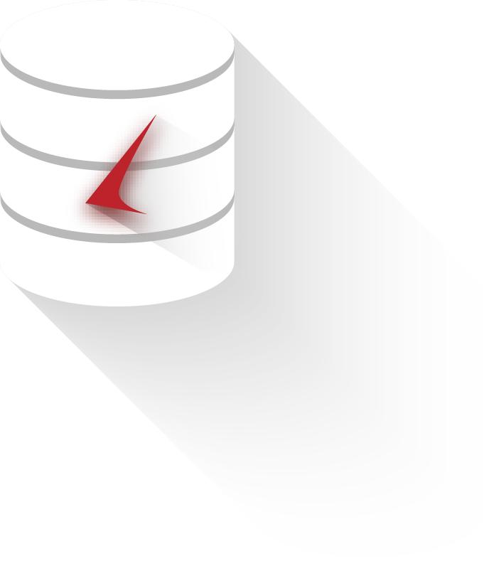
Benefits: Better Development Support
Refresh
SAN
SIT V2
Production DB Snapshots
SIT V1
SIT V1 Snapshot
Choose snapshot at specific point in business cycle.
Create VDB from Snapshot. Apply release package and table changes.
Snapshot SIT V1 after changes applied.
Create VDB from SIT V1 Snapshot. Run batch jobs. Refresh as needed.
Notes:
In another benefit, we found a better way to use Delphix’s virtual databases than we had originally planned. Originally we planned to create five new databases and use them the same way we use our existing physical databases. But, once we got into the project we came up with some new ways to use Delphix to help our development team.
The first thing we did was pick a point in time to snapshot the production database. We gave that snapshot a 365 day retention. We knew that the release would last for less than a year so 365 days seemed safe. We planned to delete the snapshot when we were done with it. We wanted to be able to come back to this clean copy of production as the basis of a new SIT database as many times as we needed.
Once we had the snapshot of PROD we created a new SIT database called SITV1. SITV1 was then a pristine copy of PROD. Next, the development team applied their release changes to SITV1. SITV1 was then a clean copy of the release. Next we took a snapshot of SITV1 and brought it down. Then we created a database called SITV2 from the snapshot of SITV1. SITV2 became the working copy of SIT. The developers ran through all of their updating batch processes on SITV2. Whenever they wanted a clean SIT database we would refresh SITV2 from SITV1.
The idea was that the developers could run through their batch processes with a copy of production at an appropriate point in the business cycle. We could refresh the SIT database back to that point on request. Multiple passes could be made against the same data. So, we would refresh SITV2 from the SITV1 snapshot whenever the development team was ready for a clean set of data.
At one point we ended up with six versions of SIT - SITV1 through SITV6, with only one up at each time. We began to figure out how to use Delphix’s fast cloning to support the development team in a way that we could not have before we had Delphix.

Slide 11


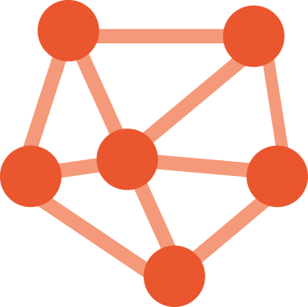

Challenges: Installation
Rush to Get In
High Ping Times
Network Flow Control
Deployed on Slower Disks
Notes:
In addition to all the benefits that I mentioned, we also experienced several challenges with our Delphix project. For some reason there was a big rush to set up the hardware and install the Delphix software. There may have been some business reason that it needed to be installed by a certain date.
One result of the rush is that we did not have enough disk space on our fast disks on our SAN and so we had to use our slow disks. This was a problem because our disk I/O times on Delphix were a lot slower than on production. It made it hard to compare our run times in test with what they would be in production. Eventually we moved to faster disks but at first it was a problem.
Also, as we prepared for the install we noticed long ping times between the Delphix machine and our HP Unix virtual machines. We expected these to be consistently under 1 millisecond but they were several milliseconds varying at random. But, we did not have time to do anything about this and it was dismissed as a misleading number. I think we also used a network throughput tool and got confusing results at first but dismissed these and decided the throughput was good enough.
The last initial challenge was some network hang-ups which crashed our test databases. Delphix support helped us address this issue with some flow control parameters.
So, our Delphix journey got off to a bumpy start but it was largely due to our own push to install the new system quickly. Ideally we would have waited to get all the disk space we needed and have worked out any network issues before installing the product.

Slide 12
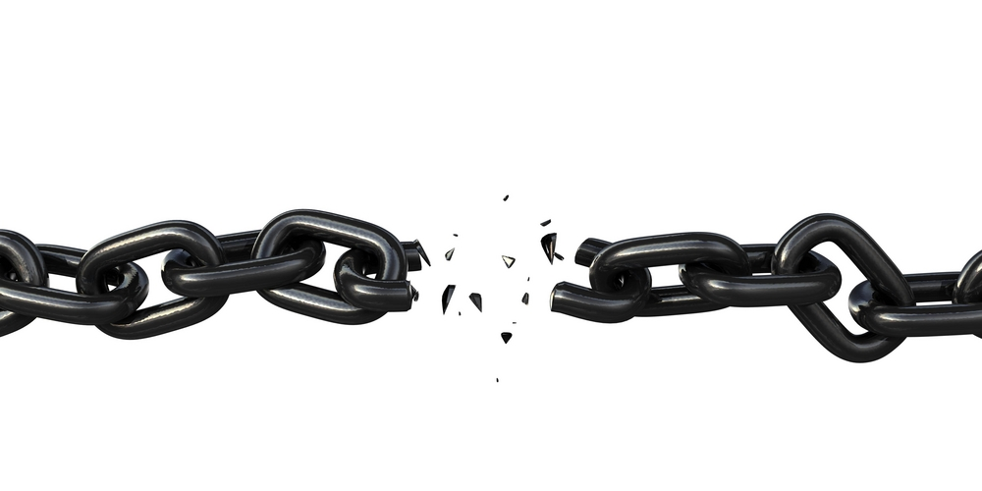
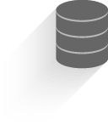

Challenges: Performance issues with first release
1
Network link too slow for full test
2
Used Delphix to move back to physical DB
3
Performance testing on refreshed QAT
Notes:
Even after resolving our initial issues, we had challenges using Delphix for our first release.
We used our suppliers SIT database to do full tests of all of the new batch processes running at the same time. These tests matched the way these jobs would run on production.
These batch jobs hung the database and ran far longer than the expected length of time. Our network connection between the SIT database and the Delphix machine was saturated and database I/O times went through the roof.
So, for the first release we moved the heavy load testing off of Delphix and on to our original physical QAT database.
Delphix made this move to a physical database easy. First I made a fast clone of our current SIT virtual database. Then I brought down the Oracle instance of this clone leaving the data files on the NFS mounted file system. Then I manually FTP’d the datafiles to the QAT host with its SAN based file systems. Lastly I renamed the new physical database to QAT. I followed the normal process to clone a physical database that was down. Delphix made this easy by quickly creating a database that I could bring down as the source for the manual clone.
So, our network throughput issues prevented us from using Delphix for heavy performance testing during our first release. But Delphix’s fast cloning made it easy to move the batch testing to a physical database and we were able to complete the release.

Slide 13
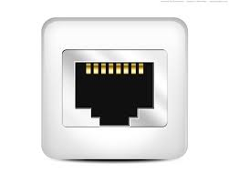
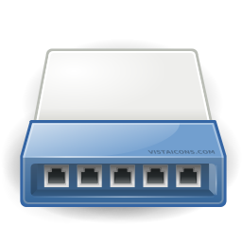

Challenges: Performance issues (cont’d)
Directly attached one VM to physical network port
Second port shared via virtual switch
Physical host
SIT VM
Virtual Switch
DEV VM
Notes:
After our first release our Unix team found a way to speed up the network connection to one virtual machine.
They connected the SIT database’s VM directly to one port of the two port network adapter on the physical host.
After this change, four of the VMs were still slow because they were going through a virtual switch. Those four VMs were slowed by the virtual switch and shared one physical port. The suppliers project was actively using the slower DEV database VM so DEV still could not handle full scale batch runs.
The remaining SIT database VM experienced solid network performance and could be used for full scale batch testing. It had unfettered direct access to a single 10 gigabit Ethernet port. From this point on we were able to use our SIT database for heavy batch performance testing without any issues.

Slide 14
Challenges: Performance Difference due to Direct I/O
Direct I/O means bypass Unix filesystem cache – required by Delphix
Production database does not use direct I/O
Direct path reads bypass database buffer cache
Batch jobs doing direct path reads faster in production
UNIX Cache
Direct Path Read
Normal I/O
DB Cache
Normal Read
Normal Read
Direct I/O
Direct Path Read
Notes:
The last challenge that we had with Delphix performance is that some batch jobs were running much longer on our SIT database than they were in production. This happened even after we got our network issues resolved. Not all batch jobs were affected, but certain ones really stood out as being much faster on production.
The Delphix virtual database’s use of direct I/O caused this performance difference. Delphix VDBs use direct I/O, but our production database does not. Delphix has to use direct I/O because of the way it uses NFS mounted filesystems. Our production database uses SAN storage with default settings so it does not use direct I/O.
Direct I/O means that the database bypasses the Unix operating system’s filesystem cache. Normally any program that reads from a Unix file has that data cached in memory by Unix. The second time it is read the file is read from memory so the read is much faster. The Oracle database is just a Unix program and the database files are just Unix files so the database files are normally cached by Unix. But, you can configure things so that Oracle bypasses the Unix cache and always reads directly from disk. This is called direct I/O. In many cases direct I/O improves database performance by eliminating an unneeded layer of caching.
We hit a case where direct I/O causes a database query to run more slowly than it would without direct I/O.
When a query uses a database feature called direct path reads it bypasses the database’s memory cache. Like Unix, the database has a memory cache so that disk blocks that are read more than once are read from memory the second time they are needed. But for full scans of large tables the database will sometimes skip the database buffer cache and read directly from disk. This is called a direct path read. It makes sense to do direct path reads for large full scans that are not going to be repeated or that read so much data that they can not be held in memory anyway.
In our problem jobs the database chose direct path reads but the table was small enough to fit in memory. The jobs also scanned that table over and over again. On production this table was cached in the Unix cache so the repeated scans were reading from memory instead of disk. On our Delphix virtual databases the same job was reading the same table over and over again from disk and bypassing both the database and unix caches. The disk reads took much longer than reads from memory.
Many Delphix customers will have production databases that use direct I/O because this is the configuration that many people recommend. Also, many applications will not have queries that use direct path reads so they would not notice the change to direct I/O. But, if you are like us and your source database does not use direct I/O and your queries do use direct path reads then your queries probably will run more slowly on your Delphix system.
This performance difference has not prevented Delphix from being useful to us for performance testing. We still have all the great benefits of fast clones of production, but we just have to be aware that certain types of queries will run more slowly on our Delphix virtual databases.

Slide 15



Implementation Notes: Replaced 5 VMs with one Physical Host
Moved off VMs to speed up network
Each DB gets good network connection
Each DB gets different directory path
  i.e. /opt/xyz/dbname instead of /opt/xyz
Used host that originally held VMs
Easily Migrated VDBs from VMs to Physical Host
1
2
3
4
Shutdown VDBs on VMs
Point VDBs to new host name – no data migration
Shutdown VMs
Bring up VDBs on physical host
Notes:
Now that I am done talking about how we overcame several challenges I want to move on to several useful notes about our implementation. The first note is about how we moved our databases off of virtual machines.
The direct connection of the SIT VM to a single network port worked great for that database. Next, we wanted to connect other VMs to their own network port but could not. Our machine only had two network ports and we could not easily add more.
At this point we realized that the only way to speed up the network for our other databases was to move them off of virtual machines.
Delphix made it easy to move our databases from virtual machines to a physical machine. We shutdown the virtual databases and their VMs and then brought the vdbs back up on a physical machine. We reused the same host that originally held the VMs. It had all the memory we needed and was connected to the correct network.
The only challenge to moving off of the VMs is that the VMs had the same directory paths as production. So, if you needed different versions of batch scripts for DEV and SIT you could have the DEV script on the DEV VM and the SIT script on the SIT VM but they would not conflict. But, once we moved DEV and SIT to the same physical machine their different scripts could not share the same directory.
Fortunately our application scripts use environment variables to define directory names. For example, in production you might have a variable called BATCHFILES which pointed to the directory /opt/xyz.
On our new physical host we would take the production directory name and add /dbname to it. So, for our SIT database the BATCHFILES variable would be set to /opt/xyz/sit, but for our DEV database it would be set to /opt/xyz/dev. This gave us a separate batch environment for each database without having each database in its own VM.
Now, all of the virtual databases have the same good network connections. They all perform as well as the one SIT database did when its VM was tied to its own network port.
HP’s virtualization caused the network bottleneck with its slow version of a virtual network switch. We finally resolved the issue by eliminating the HP virtual machines and running all of our virtual databases on a single physical host.

Slide 16
Implementation Notes: Disk Space
Need to leave 25% free
Heavy batch updates require more disk space
  Production Updates
    More changed blocks per snapshot
    More archive logs
  Testing updates
    Larger VDBS
Notes:
Next, I wanted to note some things about how Delphix uses disk space.
Delphix’s fast cloning is a product of the way it uses disk storage. A clone is created without copying large amounts of data. A clone just points to blocks Delphix already has. This also means that Delphix needs a lot less disk space than other cloning methods. But, we ran into several factors that led to greater disk space usage by Delphix than we expected.
First, let me give you an idea of how much disk space we have and what it supports. Our Delphix machine has 8 terabytes of real disk storage attached. This 8 terabytes supports a 6 terabyte production database and a 1 terabyte development database as sources with 6 to 8 target databases.
You have to leave about 25% of your disk space free for Delphix to be fully functional, so really we are only using 6 of our 8 terabytes total real disk space.
We had a heavy updating batch environment in production and so that expanded our disk space needs. Snapshots record updated blocks and archive logs are backed up so you can run a recovery to a point between snapshots. The heavier your updating in production the more disk space you will need.
The whole point of our project was to develop and test some new heavy batch updating jobs. So, these jobs also required more disk space because heavy updating in a virtual database requires more disk space to hold the vdb blocks that were changed.
Delphix was a very helpful tool to us with its fast clones and refreshes, but it probably required more disk space than expected. Now that we understand how Delphix uses disk space we can better estimate how much space future projects will need.

Slide 17
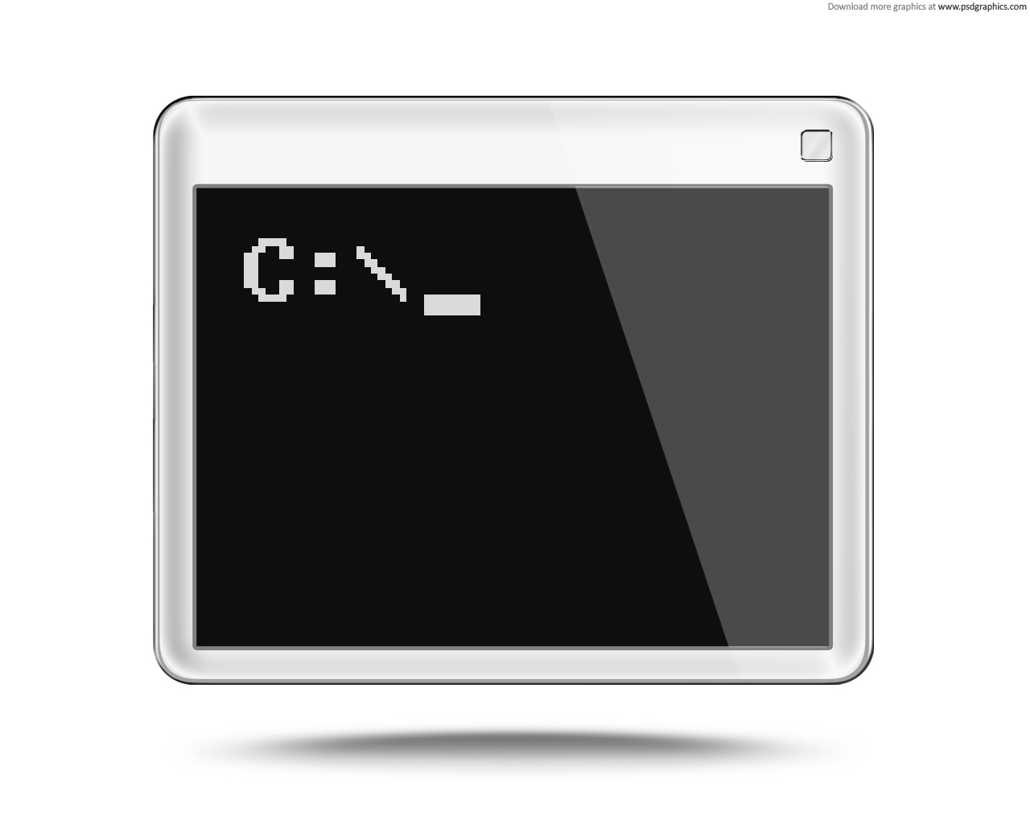
Implementation Notes: Refresh Scripts
Before and after refresh scripts
  Users and passwords, permissions, directories
  Resize redo logs
Refresh Script
  Command line instead of GUI web page
  SSH to Delphix Machine
  Command language
Delphix consulting developed
Sudo to let developers run own refresh
Notes:
Lastly, I wanted to tell you about a great set of scripts that we have that make it easy to refresh our Delphix virtual databases.
We have pre and post refresh scripts. We preserve any information that is different from production and restore it after the refresh is complete. For example, we save all of the developers’ usernames and passwords along with their permissions. After the refresh is done we restore the developers usernames, passwords and permissions. It seems to them that nothing happened.
Delphix consulting wrote our initial before and after scripts and I added things to them as needed.
We did not use it, but Delphix consulting also wrote a script that would run the refresh itself. So, instead of having to go through the web page and running a refresh I could run a Unix script.
We built a master script that the the developers could use to do a refresh themselves. It called the pre and post refresh scripts before and after the refresh script. We set certain developers up in sudo so they could run the master script themselves.
But, so far I have been doing all of the refreshes manually. The developers are too worried that they will run the refresh at the wrong time. Also, they frequently need something that is not included in the existing refresh script.
I manually run the before script, do the refresh through the web interface, then run the after scripts. It works great and Delphix consulting was a big help getting this set up initially. The refresh scripts make the fast cloning that much more useful.

Slide 18

Conclusion
Successful project to move supplier app off mainframe
Supported three releases of major development project
Performed key recovery of production data
Depends on good network connection
Must use direct I/O
Fast physical clone of production
Notes:
I have tried to walk through the lessons we have learned about Delphix. Hopefully I have given you a balanced picture of the ups and downs of my work with Delphix with the benefits and challenges along with additional notes.
Even in the midst of challenges we have consistently experienced the benefits of fast cloning of large databases.
Our main project to move our suppliers application off of our mainframe has completed with all three releases supported by Delphix.
We also had the unplanned benefit of a fast and easy production recovery even in the midst of some technical challenges from an Oracle bug.
Most of our performance challenges revolved around slowness of our network link between the Delphix machine and our virtual databases. A limitation in HP’s version of a virtual network switch caused this slowness.
We also discovered that Delphix requires you to use direct I/O and this led to performance differences that we had to account for since our production database does not use direct I/O.
I really like the ability to make fast clones of production. It was not easy to resolve some of the issues that we had with Delphix, but I can not get around how helpful it is to spin up a new copy of a 6 terabyte database in minutes.
I hope this presentation has been helpful to you. I am happy to answer any questions you have now, and my contact information is on the next slide if you want to get in touch with me in the future.

Slide 19
QUESTIONS?
bobby@bobbydurrettdba.com
http://www.bobbydurrettdba.com

